Slide 1








GROUP PROJECT
Presented by Squad

Slide 2


Slide 3


Slide 4





Slide 5



Slide 6


Slide 7
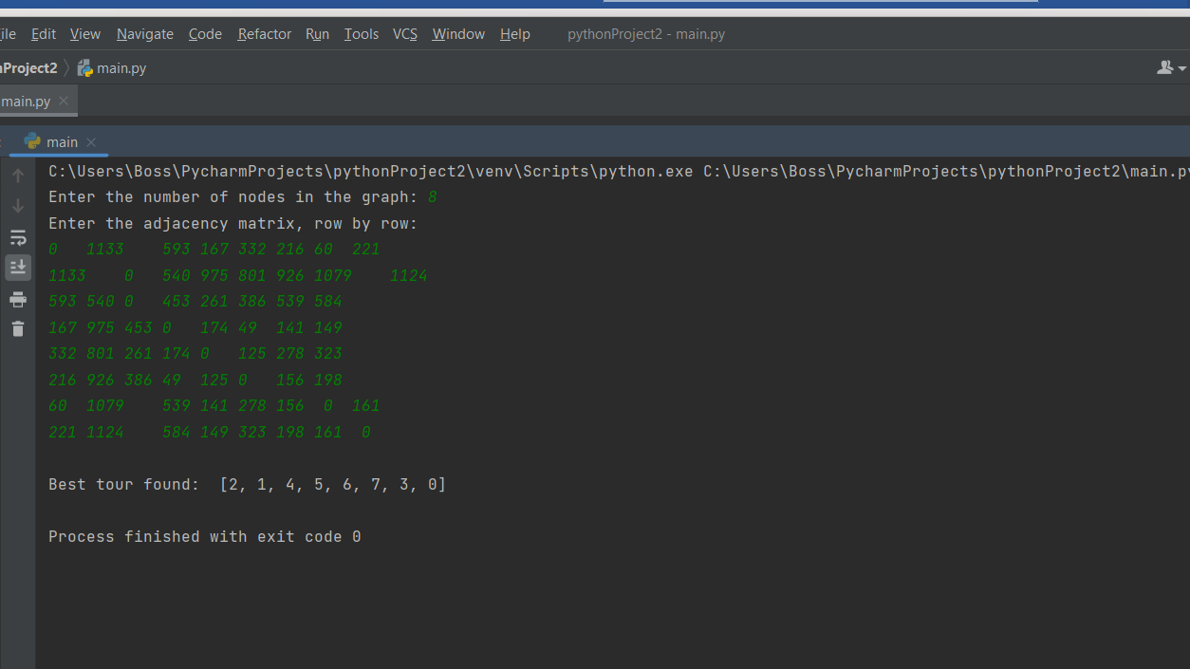
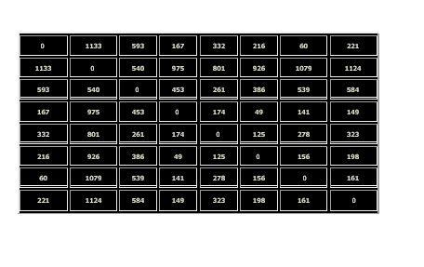
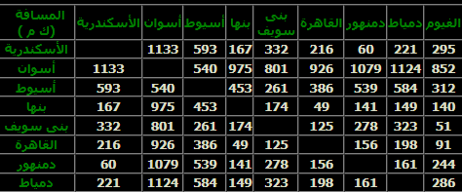


Slide 8
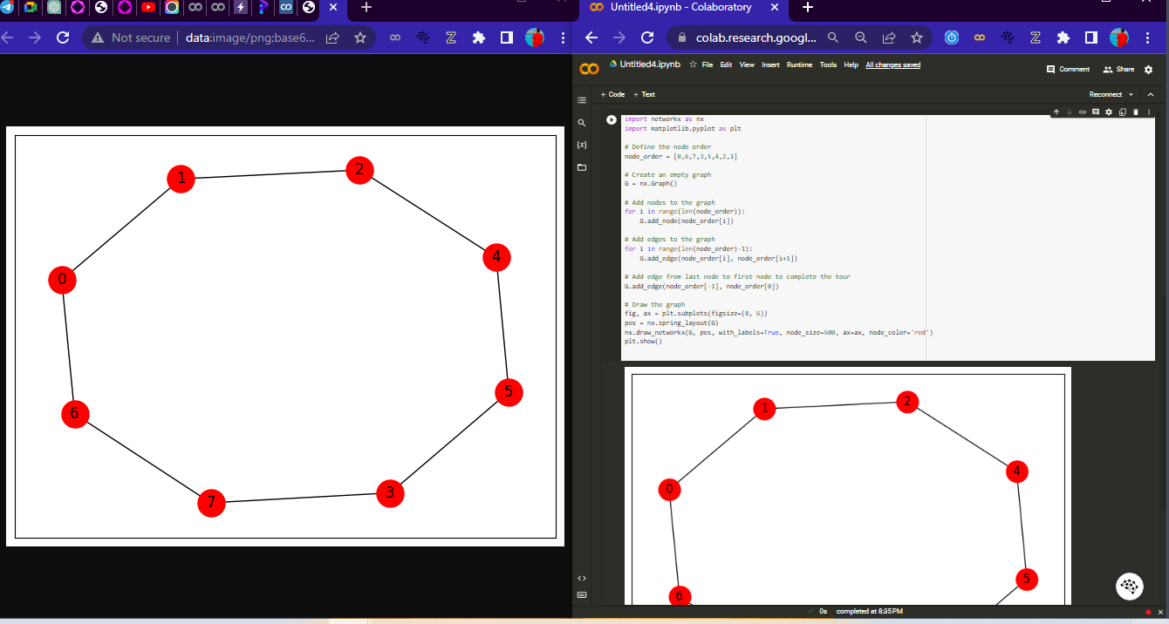

Slide 9


Slide 10
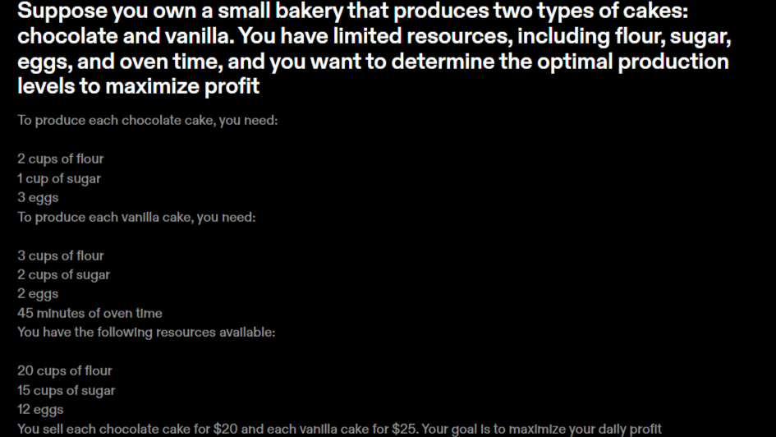

Slide 11
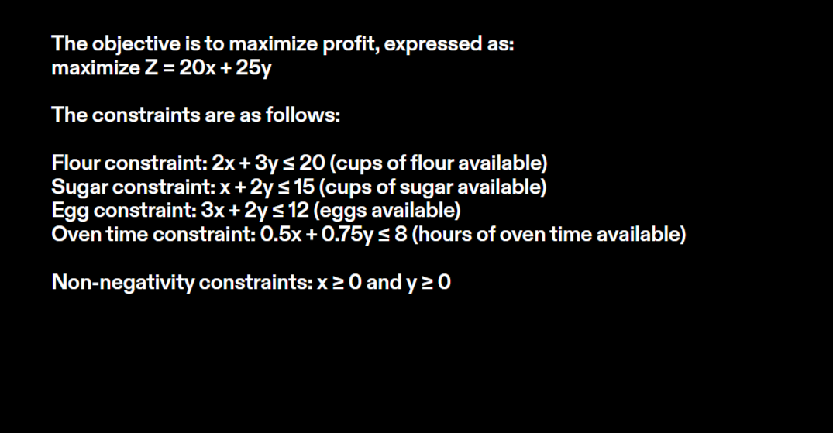
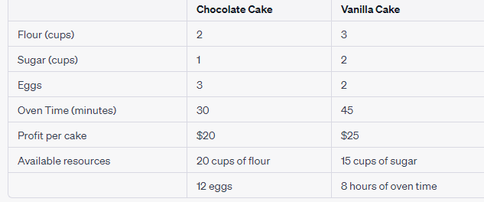

Slide 12

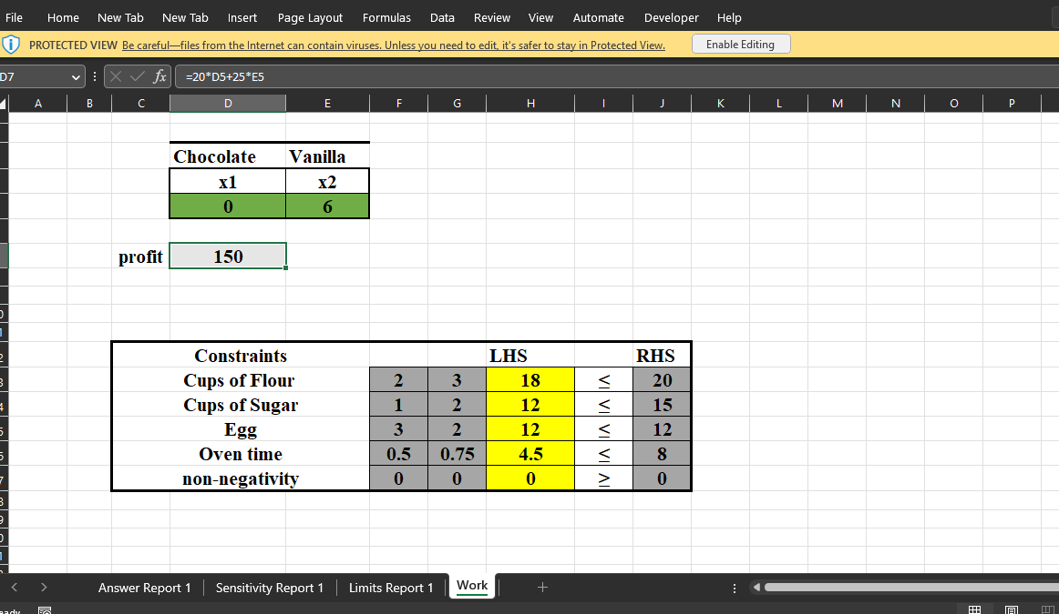

Slide 13


Slide 14


Result
Result
we find that the optimal production levels for chocolate and vanilla cakes are:
x = 0 cakes X2 = 6 cakes
At this production level, the bakery can achieve a daily profit of $150

Slide 15






